Slide 1
Car rental system
You're better off driving our way

Slide 2
Group details
Group No : 13
Members : B32 Mansuri Mohammed Sufyan
B43 Patel Harshil
B55 Shahu Dipakkumar
Guide : Het Rachh

Slide 3
definition
Car rental system allows individuals to book a self-drive rental car by the hour, day, week, or month. It seamlessly integrates into any platform as it is a web app. Our service enables users to rent self drive cars for traveling in the city or outstation.

Slide 4
Technologies
Front End : HTML, CSS, Javascript
Back End : Django ( Python )
Database : MySQL

Slide 5
Features
Easy Bookings
Testimonials
Quick and secure payment
User management
Fleet Management
Website Analytics
Customer Support

Slide 6
Modules
Customer
Login/Logout.
View fleet.
View their transaction history.
View & manage their account details.
View & give feedback

Slide 7
Modules
Admin
Login/Logout.
Admin can view & manage fleet.
Manage bookings.
Manage users.
View & manage feedback.

Slide 8
Modules
Visitor
Register.
View fleet.
View Testimonials.

Slide 9
Advantages
Saves time and cost
The car rental system present instant support to the clients.
The car rental system gives an easy booking facility for the clients.
The receipts can be easily generated from the rental system.
The clients can make advance payment online and bookings for the cars.

Slide 10
Limitations
Internet Connectivity
Limited Pickup & Drop Points
GPS tracking

Slide 11
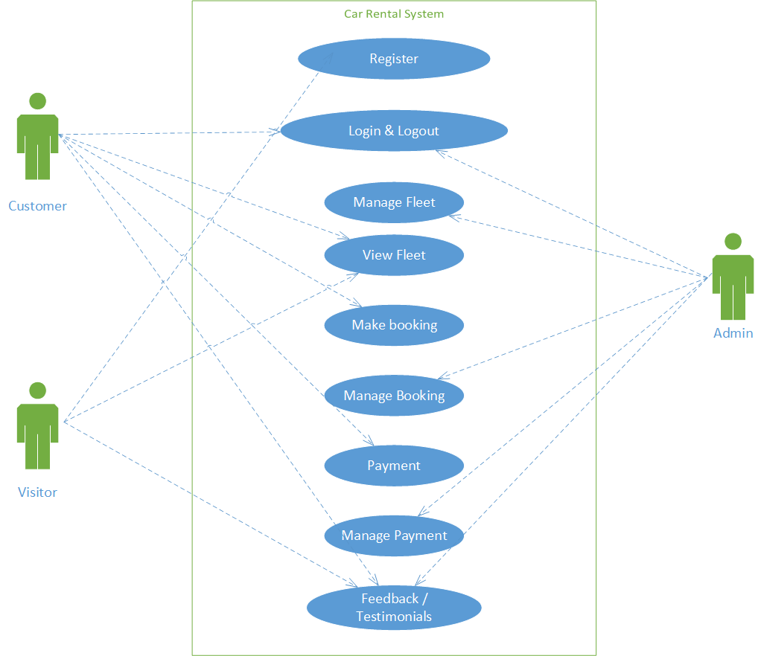
USE CASE

Slide 12
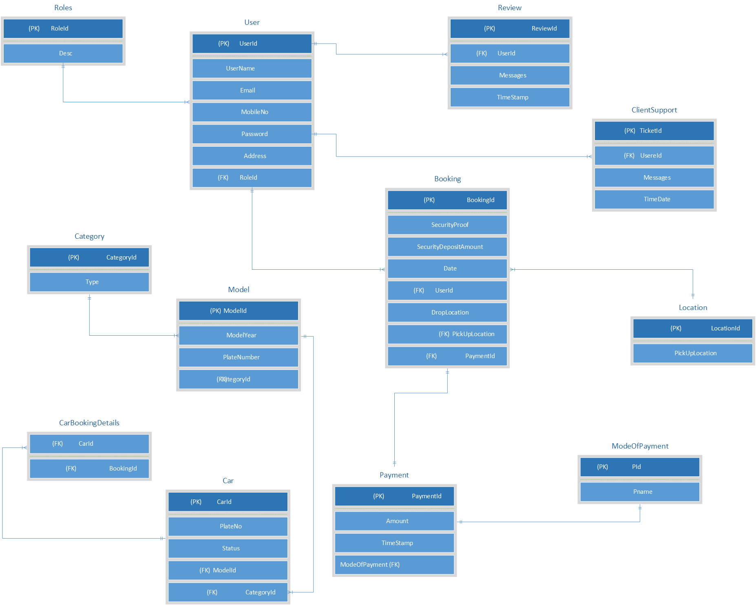
ER DIAGRAM

Slide 13
Data dictionary
Roles
Field name | Data type | Constraints | Description
RoleId | INT | PRIMARY KEY | Id of role
Desc | VARCHAR(45) | NOT NULL | Description of role

Slide 14
USER
Field name | Data type | Constraints | Description
UserId | INT | PIMARY KEY | Id of user
UserName | VARCHAR(45) | NOT NULL | Name of user
Email | VARCHAR(45) | NOT NULL | Email of user
MobileNo | INT(10) | NOT NULL | Mobile no of user
Password | VARCHAR(16) | NOT NULL | Password of user account
Address | VARCHAR(45) | NOT NULL | Address of user
RoleId | INT | Foreign Key | Type of user

Slide 15
BOOKING
Field name | Data type | Constraints | Description
BookingId | INT | PRIMARY KEY | Id of Booking
SecurityProof | VARCHAR(45) | NOT NULL | Id proof of user
SecurityDepositAmount | DECIMAL | NOT NULL | Deposit amount
Date | DATETIME | NOT NULL | Booking date
UserId | INT | FOREIGN KEY | Reference of user table
DropLocationId | INT | NOT NULL | Droplocation of user
PickuplocationId | INT | FOREIGN KEY | Pickuplocationid of user
PaymentId | INT | FOREIGN KEY | Reference of user payment

Slide 16
carBookingdetails
Field name | Data type | Constraints | Description
CarId | INT | PRIMARY KEY | Id of car
BookingId | INT | FOREIGN KEY | Reference of Booking table
LOCATION
Field name | Data type | Constraints | Description
LocationId | INT | PRIMARY KEY | Id of location
PickUpLocation | VARCHAR(45) | NOT NULL | Pickuplocation of user

Slide 17
category
Field name | Data type | Constraints | Description
CategoryId | INT | PRIMARY KEY | Id of category
Type | VARCHAR(45) | NOT NULL | Type of category
MODEL
Field name | Data type | Constraints | Description
ModelId | INT | PRIMARY KEY | Id of model
ModelYear | VARCHAR(45) | NOT NULL | Modelyear of car
PlateNumber | VARCHAR(45) | NOT NULL | Platenumber of car
CategoryId | INT | FOREIGN KEY | Reference of category

Slide 18
Car
Field name | Data type | Constraints | Description
CarId | INT | PRIMARY KEY | Id of car
PlateNo | VARCHAR(10) | NOT NULL | Plateno of car
Status | VARCHAR(45) | NOT NULL | Status of car
ModelId | INT | FOREIGN KEY | Reference of model table
CategoryId | INT | FOREIGN KEY | Reference of category table
CLIENT SUPPORT
Field name | Data type | Constraints | Description
TicketId | INT | PRIMARY KEY | ID of ticket
UserId | INT | FOREIGN KEY | Reference of user table
Messages | VARCHAR(45) | NOT NULL | User messages
TimeDate | DATETIME | NOT NULL | Current datetime

Slide 19
review
Field name | Data type | Constraints | Description
ReviewId | INT | PRIMARY KEY | Id of Review
UserId | INT | FOREIGN KEY | Reference of user table
Messages | VARCHAR(45) | NOT NULL | Messages of user
Timestamp | DATETIME | NOT NULL | Date and time of user

Slide 20
PAYMENT
Field name | Data type | Constraints | Description
PaymentId | INT | PRIMARY KEY | Id of Payment
ModeOfpayment | INT | FOREIGN KEY | Reference of paymentmode
Amount | DECIMAL | NOT NULL | Paid amount
Timestamp | DATETIME | NOT NULL | Date and time of user
MODE OF PAYMENT
Field name | Data type | Constraints | Description
Pid | INT | PRIMARY KEY | Id of payment
Pname | VARCHAR(45) | NOT NULL | Payment name

Slide 21
Thankyou

